Slide 1

Setting up your optimization problem
Vanishing/exploding
gradients
deeplearning.ai

Slide 2


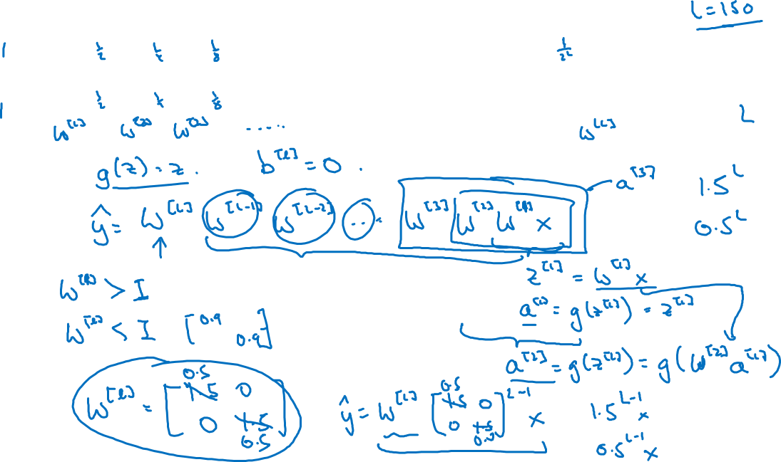

Vanishing/exploding gradients
$x_{1}$
$$\hat{y}$$
$x_{2}$
=

Slide 3






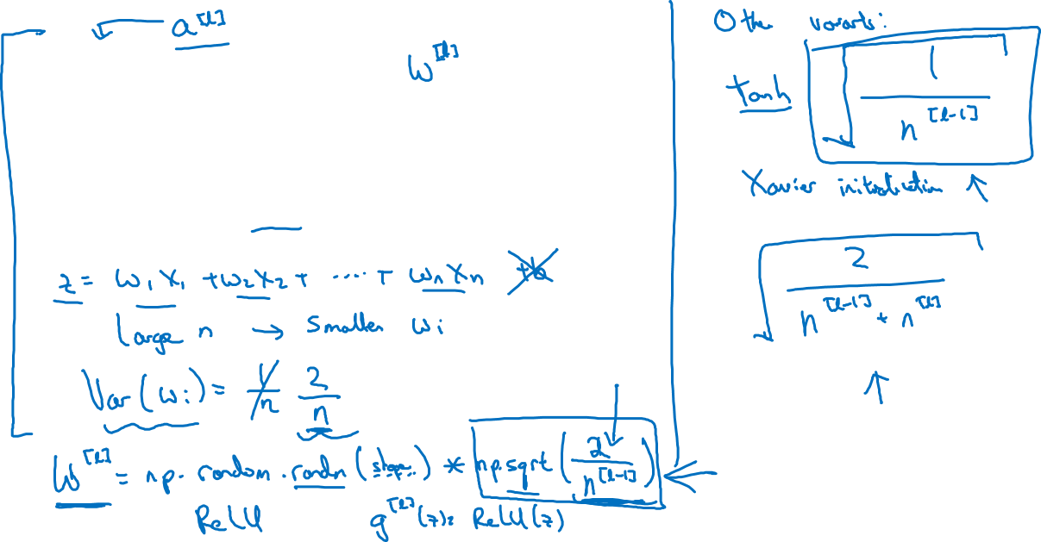
Single neuron example
$x_{1}$
$x_{2}$
$$\hat{y}$$
$x_{3}$
$x_{4}$
$$a=g(z)$$

